Slide 1
Sprint Review 2024-01-15
Diane Wold, Sr. Director, Standards Development

Slide 2
Agenda
Defining Rules
New Rules this Sprint
Rules Engine Capability

Slide 3
Defining Rules
Rules for foundational standards such as SDTM are defined by the development teams and recorded in a spreadsheet.
Until this sprint, rules were defined by the rules team with minimal input by the development team.
This spring, the rules team worked with Berber to define rules, and we now have a document which describes multiple rules in 8 different categories.
We now have a good supply of rules to develop, although not all of them can be created within the rules engine at present.

Slide 4
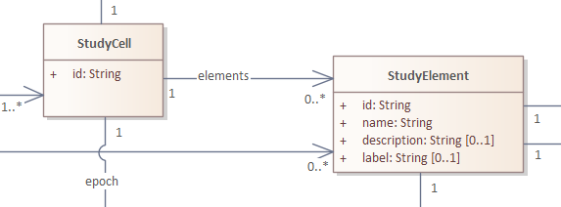
New Rule this Sprint
Each StudyCell must have at least one Element

Slide 5
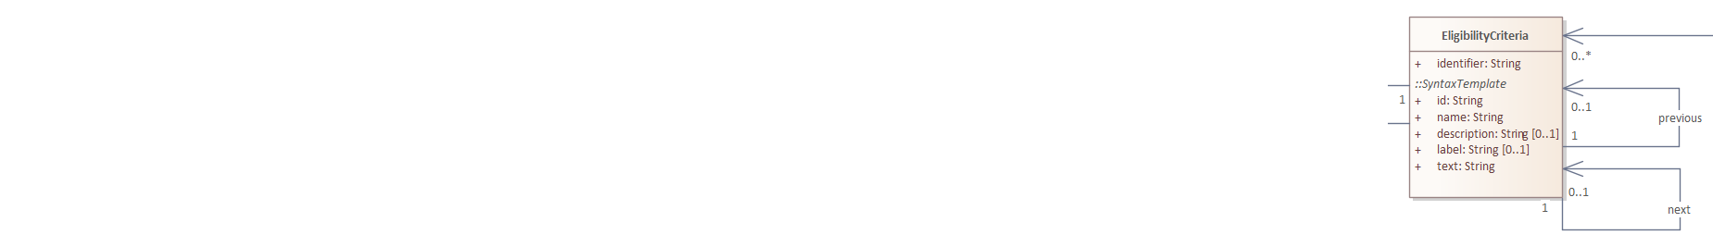
New Rule this Sprint
An instance of a class cannot be previous to or next after itself.
Also, an instance of a class cannot be a child of itself or a default condition for itself.

Slide 6
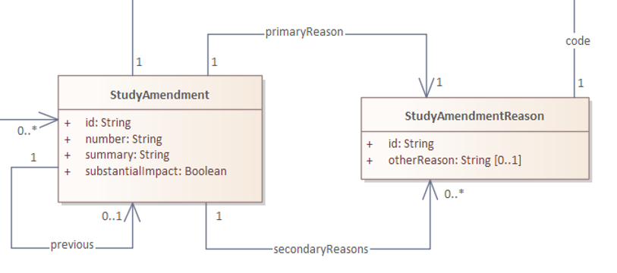
New Rule this Sprint
If the code for a StudyAmendmentReason is “other”, then otherReason must exist.
If the code for StudyAmendmentReason is not “other”, then otherReason must be null.

Slide 7
Rules Engine Capability
Work to support of USDM JSON data sources in the rules engine was started, but not completed in this sprint.
The rules engine accesses terminology from the CDISC Library. Since USDM is not yet supported by CDISC Library, terminology checking is currently blocked.
The USDM terminology includes associations between classes and particular codelists, similar to associations documented in codetable mapping files for SDTM. Those codetable mapping files are not currently in CDISC Library, so complete support of USDM terminology in CDISC Library will likely require further CDISC Library development.

Slide 8
Pivot Day 2023-12-18 Progress on Defining Rules

Slide 9
Agenda
Rules Engine Constraints
Within-class Rules
Generalized Rules
Trial Summary Consistency with Study Design
Checking Controlled Terminology

Slide 10
Rules Engine Constraints
Need strategy for “schema checking” (cardinality, datatype)
Need capability for checking across classes
Continue to define rules, though creation of many is blocked

Slide 11
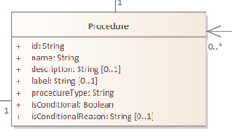
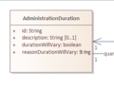
Checking within Classes
One of the first rules
Last within-class rule identified

Slide 12
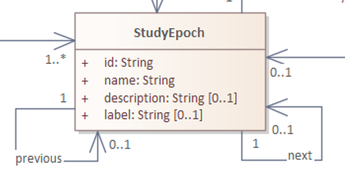
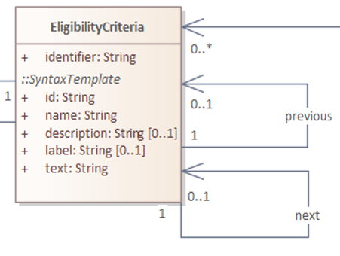
Generalized Rules
Three rules:
Name 1:1 with description
Name 1:1 with label
Next and Previous create order
Generalized all three rules
to other classes.
Added rule: Name 1:1 with text

Slide 13
Trial Summary Consistency with Study Design
If TSPARM = "Intervention Model" and TSVAL = "CROSSOVER" then there must be at least two StudyInterventions.
if TSPARM = "Trial Type" and TSVAL = "TREATMENT", then TSPARM = "Trial Disease/Condition Indication" must be present and populated.

Slide 14
Checking Controlled Terminology
For every link to non-extensible controlled terminology, confirm that
Note that “code system” must be specific, e.g., specifying appropriate CDISC codelist, not just “CDISC”
The code is in the controlled terminology version cited
The decode is the value associated with the code
For extensible codelists
If code is in the controlled terminology version cited, check as above
If there is no code or the code is not in the controlled terminology, return a warning message
Follow up with a manual check that code (if present) and decode are appropriate?

Slide 15
Thank You!

